Slide 1

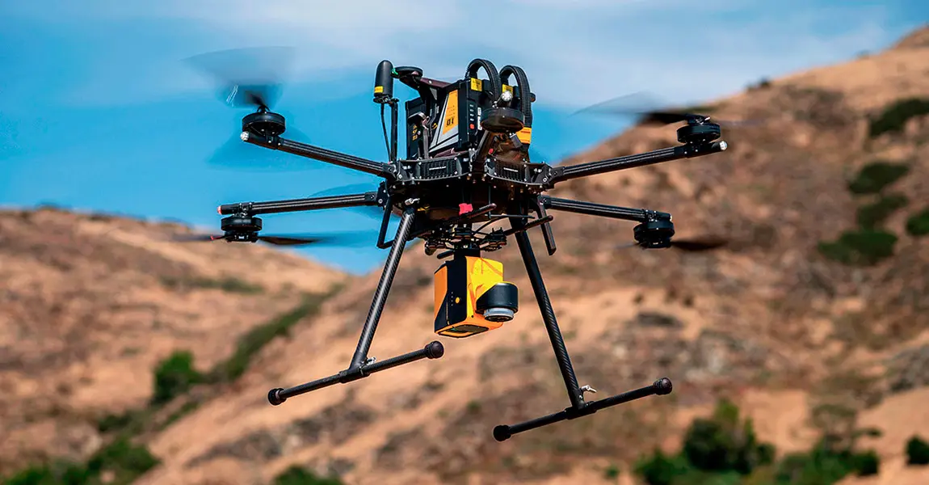
BALTIC GHOST WING COE & PROVING GROUNDS
CAPES BRIEF NOV. 2024
GET STARTED >

Slide 2
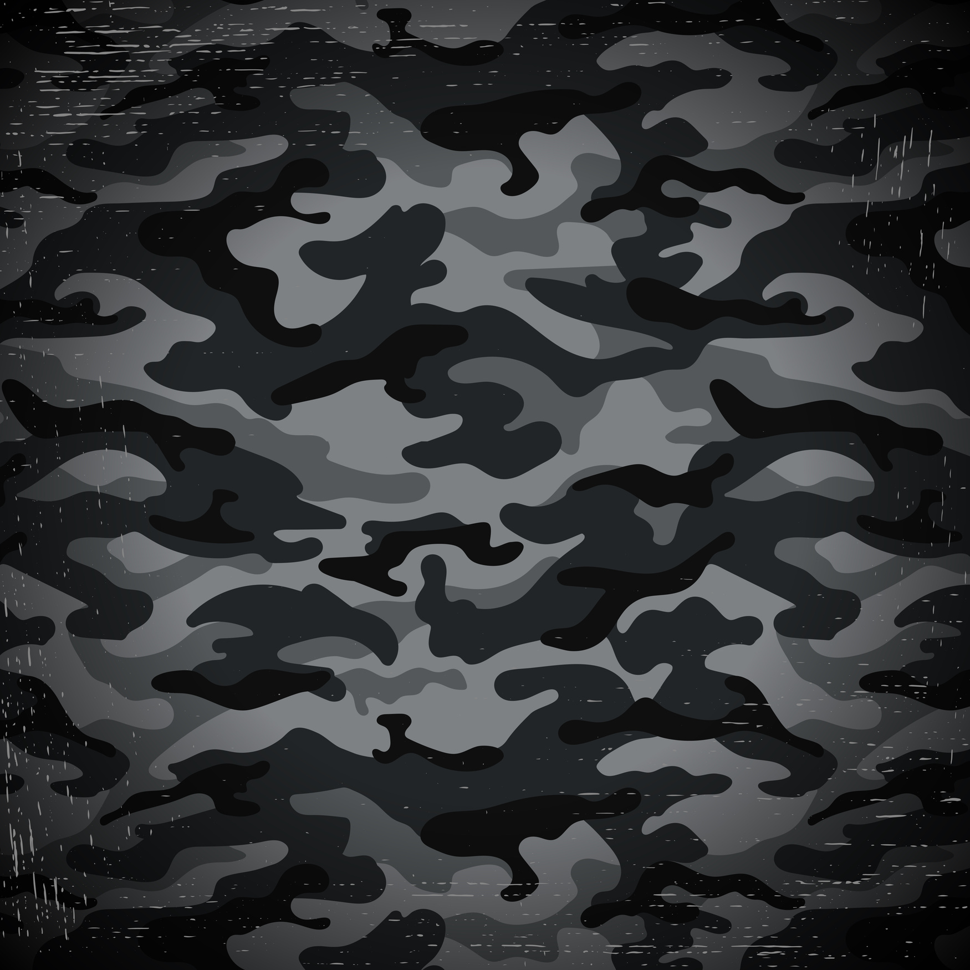


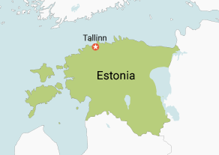
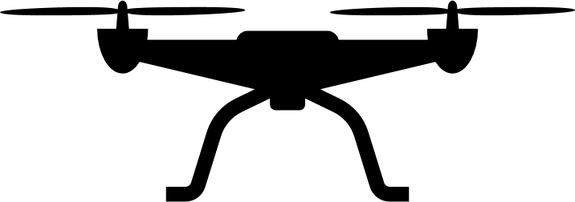
Bal
BALTIC GHOST WING CENTER OF EXCELLENCE
Jõhvi
Sonda
Võrtsjärv
Latvia
“ Unmanned Ground, Maritime, and Air ranges throughout Estonia and Latvia”
Copyright © 2024 Baltic Ghost Wing COE

Slide 3
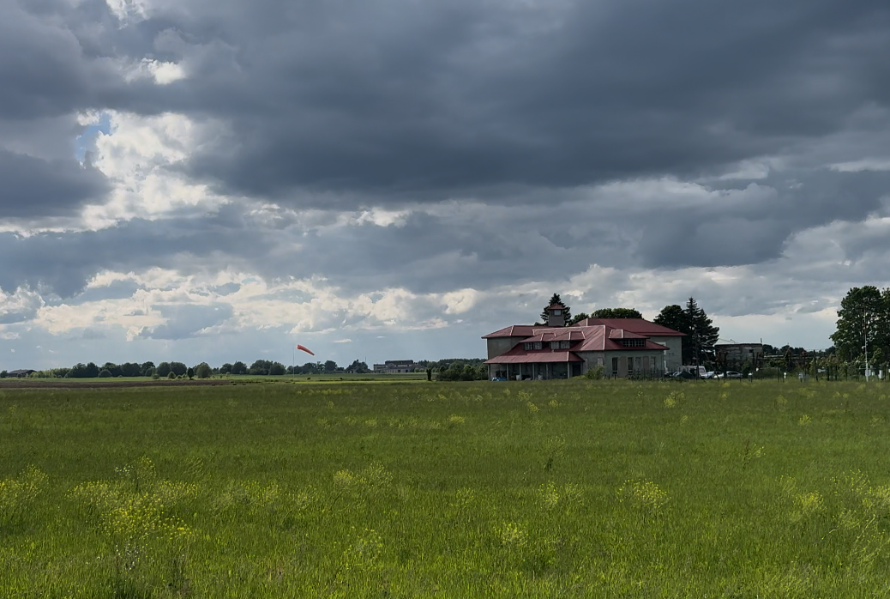
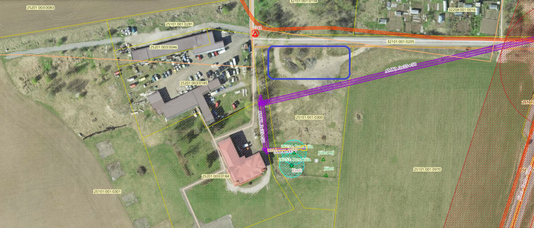
Bal
WHAT IS BALTIC GHOST WING CENTER OF EXCELLENCE ?
UAS
BGWCOE is the planned premier UAS testing proving grounds and advanced piloting training center in the world opening in Jan 2025 and located in Jõhvi and Sonda, Estonia. We provide proving grounds, simulated environments including commercial and dual use, and drone testing facilities at our locations. Separately we are able to provide advanced FPV, FW, and ISR drone instruction. We have over 50 trained instructors with current experience in Ukraine & Middle East
“ We train and provide a world class training ground to the aspiring and existing UAS ecosystem”
Copyright © 2024 Baltic Ghost Wing COE

Slide 4
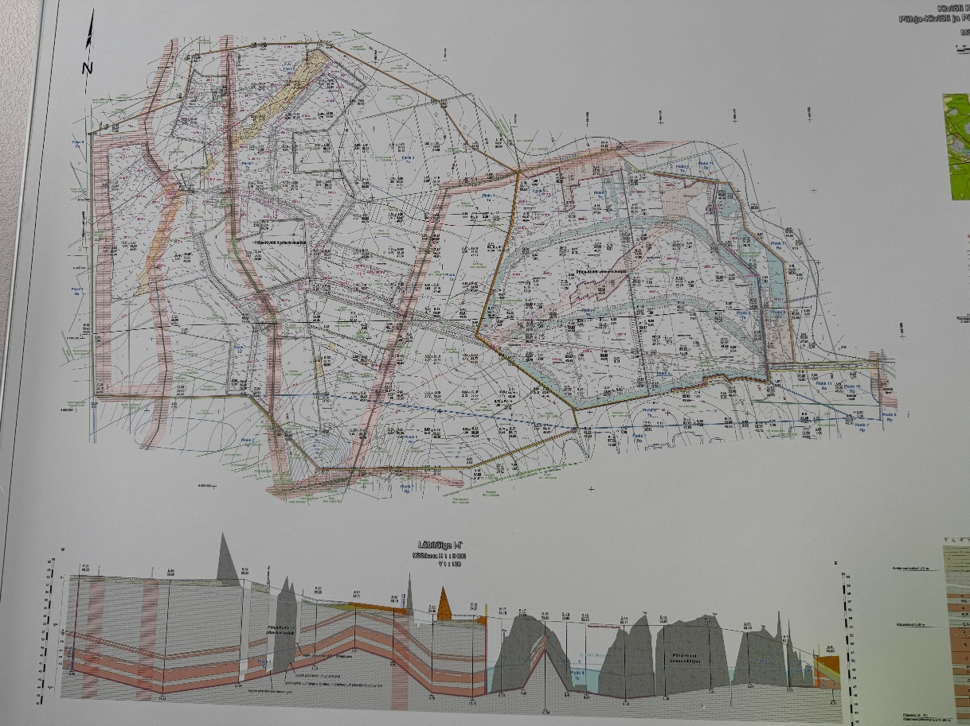
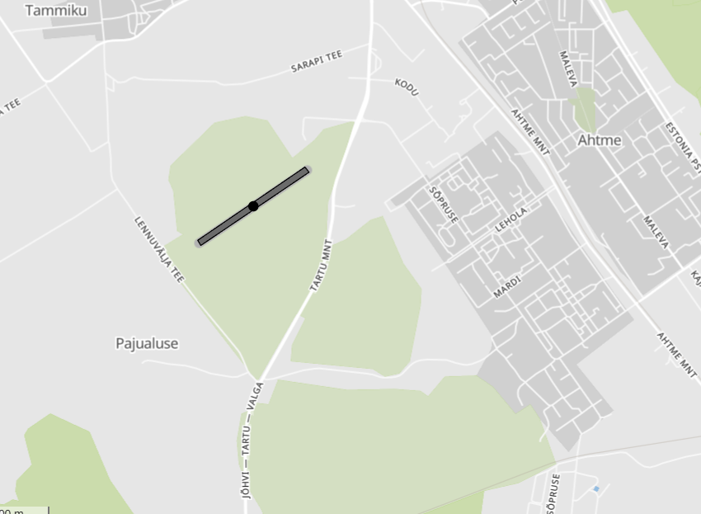
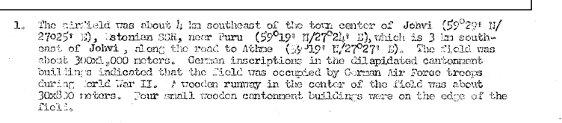
SONDA AND JOHVI PROVING GROUNDS
UAS
BGWCOE maintains operational testing areas in Jõhvi and Sonda, Estonia. Both VLOS and BVLOS (with Estonian defence support) are possible at our ranges. BGWOCE is known throughout the drone community and is currently establishing MOUs with a variety of clients and partners to include AI, UAS, UGV, USV and other industry partners.
BGWCOE primary goal is to allow all types of commercial and dual use drone companies to test under various (and extreme) testing conditions in Estonia. These conditions replicate other eastern European and cold weather climates.
Copyright © 2024 Baltic Ghost Wing COE

Slide 5
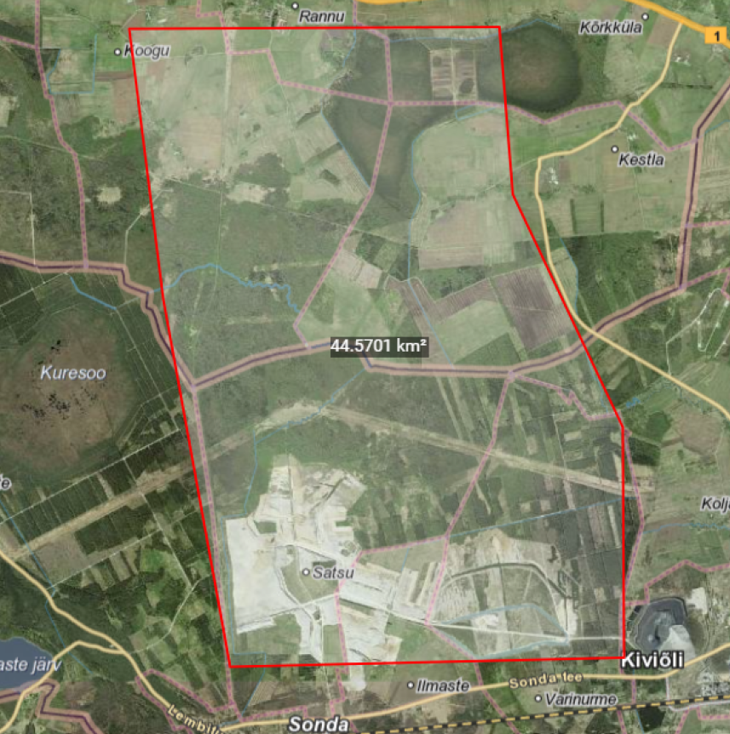
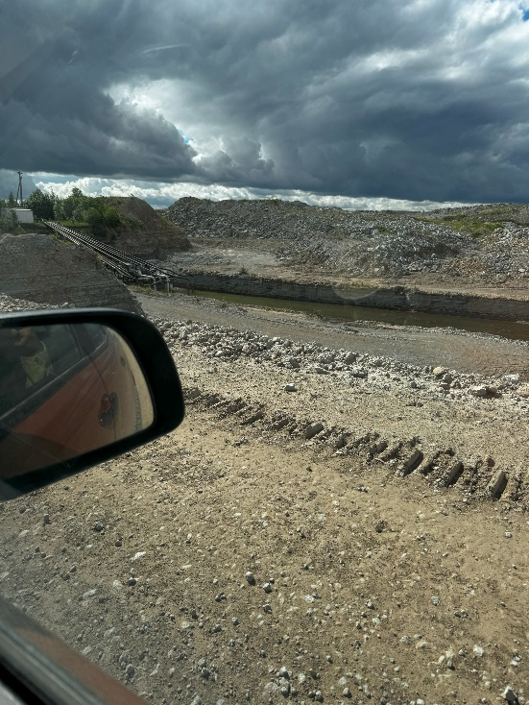
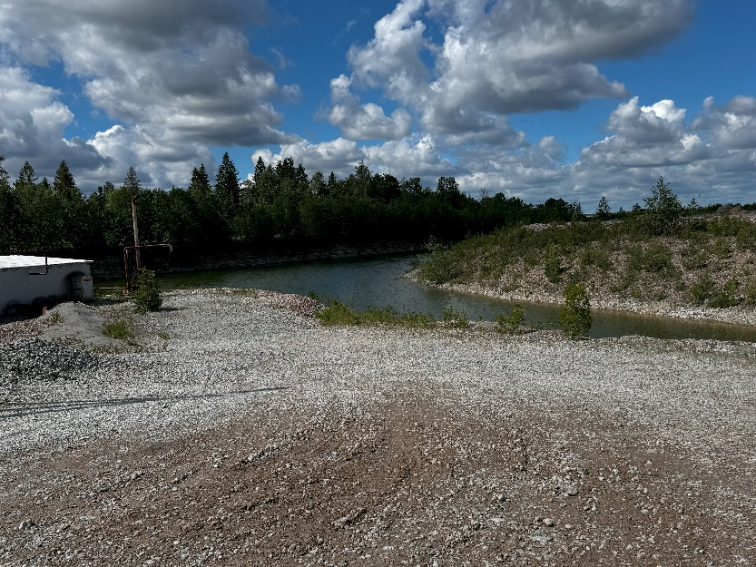
Bal
SONDA 43-X PROVING GROUNDS
BGWCOE confirmed the availability of the SONDA X-43 Range in cooperation with Alexela. This range is a total of 44.5 km2 (expanding to over 100km2) and is extremely discreet and this ground area is covered by a quarry only. No people live in this area. The highest elevation is 150m on top of shale oil piles. Mobile shelters are available for use in this area as mobile classrooms.
“ The most secure training areas in Europe”
Copyright © 2024 Baltic Ghost Wing COE

Slide 6
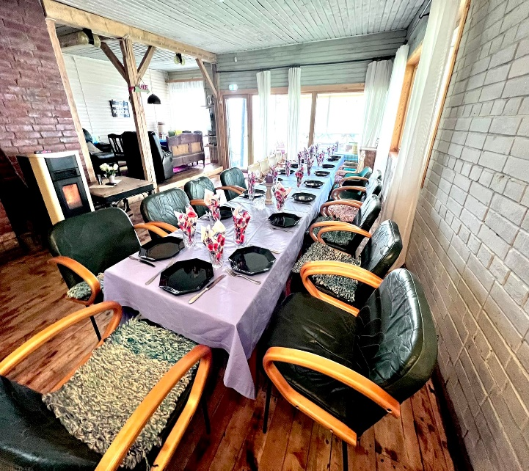
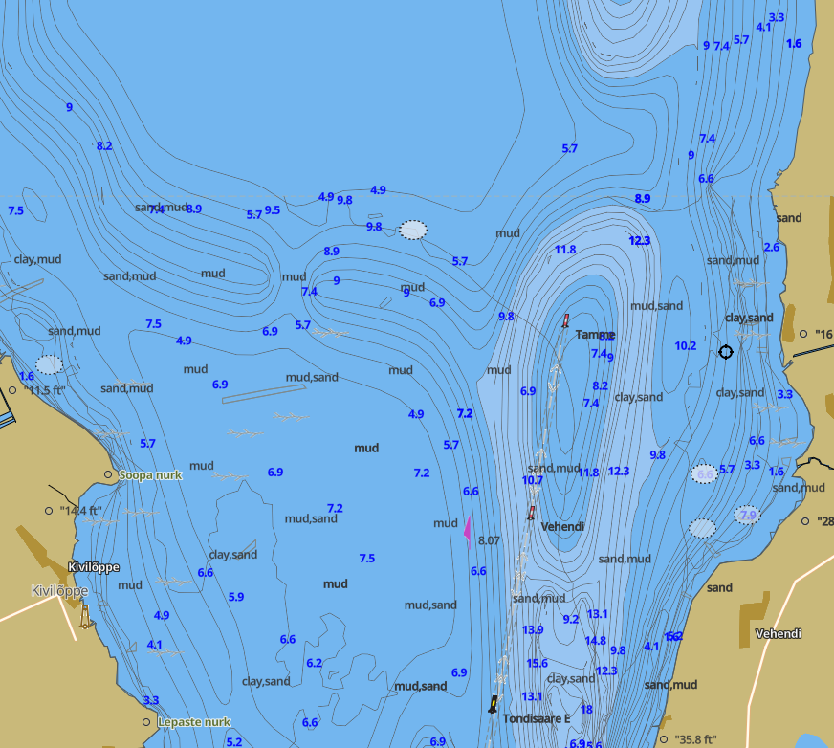
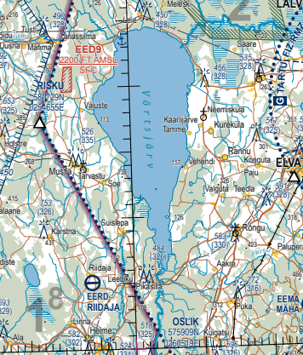
Bal
Võrtsjärv, Estonia
Baltic Ghost Wing's new center in Võrtsjärv, Estonia, is a cutting-edge marsupial and amphibious facility, supporting operations for unmanned surface vehicles (USV), unmanned underwater vehicles (UUV), and unmanned aerial systems (UAS). This expansion enhances capabilities in multi-domain unmanned technology testing and training.
“Intermodal is the next frontier in unmanned systems”
Copyright © 2024 Baltic Ghost Wing COE

Slide 7



DRONE PILOT GROWTH OUTLOOK
The European drone industry is expected to grow at a compound annual growth rate (CAGR) of 8.62% from 2024 to 2029, expanding from an estimated market value of USD 7.32 billion in 2024 to USD 11.07 billion by 2029, as reported by Spherical Insights.
This growth is driven by the increasing application of drones in sectors such as construction, agriculture, and energy, according to Mordor Intelligence.
Further technological advancements and regulatory changes are anticipated to fuel the expansion of the drone industry in Europe.
Globally, there is a rising demand for pilots, including drone operators, as unmanned aerial vehicles (UAVs) become more integrated into commercial, civilian, and military activities.
CAE's Aviation Talent Forecast indicates that the aviation industry will need 252,000 new commercial pilots worldwide in the next decade, a demand propelled by industry growth and the retirement of current pilots.
Copyright © 2024 Baltic Ghost Wing Academy
6

Slide 8
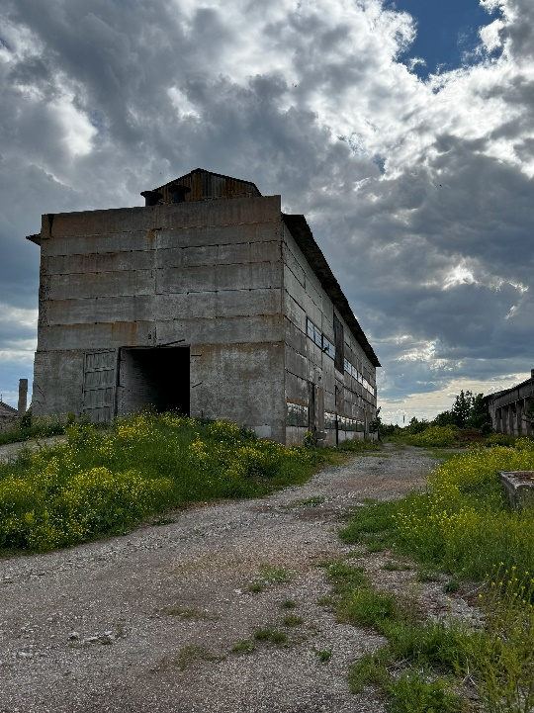
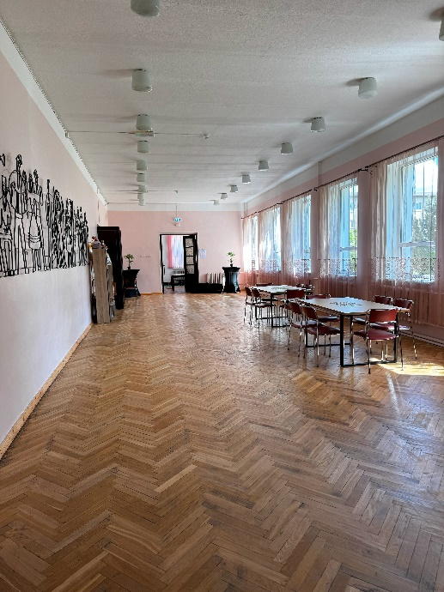
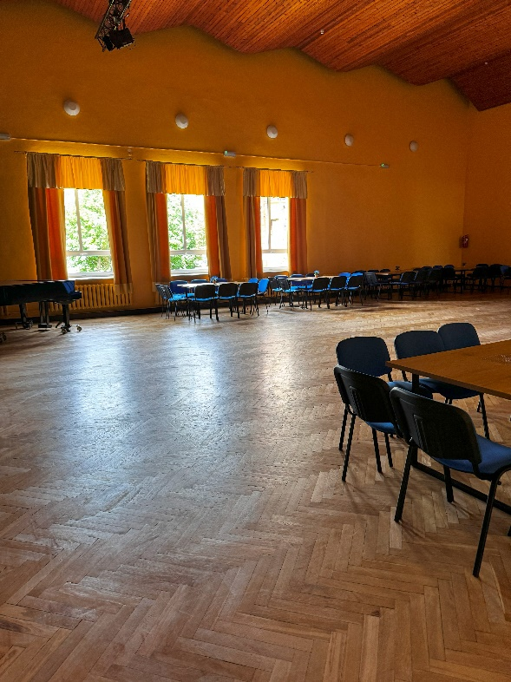
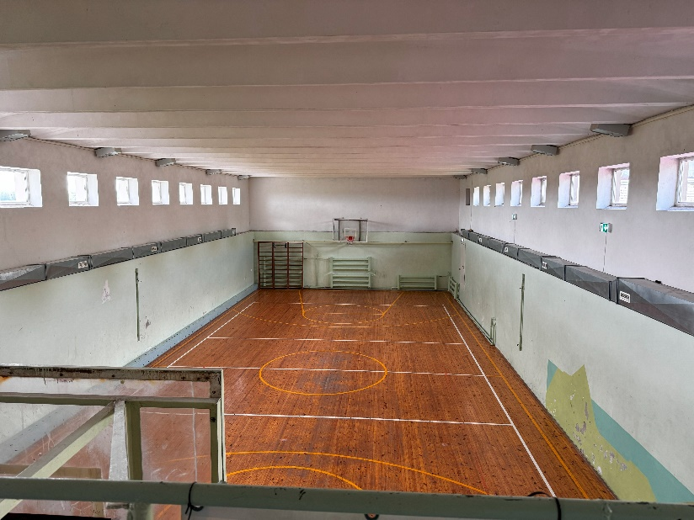
TRAINING CENTER
BGWCOE uses public and private facilities in Jõhvi, Estonia with the support of the local government. This includes indoor gyms and classrooms and portable containers at the airport. Each presents unique training and testing locations. This includes indoor sports halls and municipal buildings. Indoor FPV is available at multiple locations.
BGWCOE works in conjunction with Jõhvi city government in relationship to computer and private/public classrooms.
Copyright © 2024 Baltic Ghost Wing COE

Slide 9
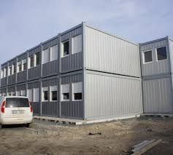
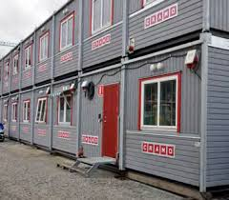
FUTURE TRAINING CENTER
BGWCOE will deploy portable containers to the airfield in Jõhvi for use as hangars and classrooms. Optional storage will also be included in these facilities.
BGWCOE is collocated at Jõhvi regional airport in Ida Virumaa, Estonia
Copyright © 2024 Baltic Ghost Wing COE

Slide 10
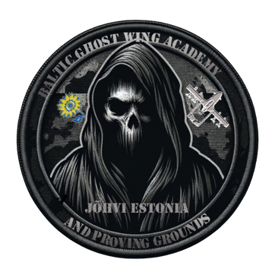
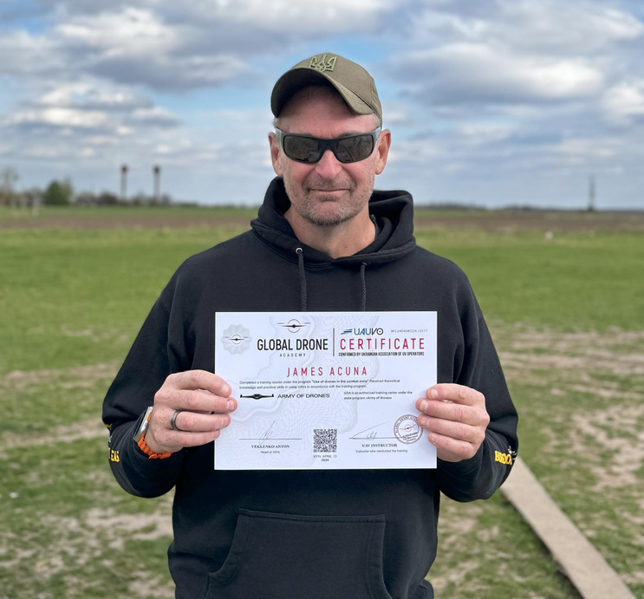
WHO IS THIS GUY?
JAMES ACUNA
20 Years Directorate of Operations CIA
10 Years Supporting DARPA MTO/TTO
Certified Part 107 Drone Pilot
Military Drone Experience in Europe
Certified in Ukraine
Based in Estonia
Copyright © 2024 Baltic Ghost Wing Academy
5

Slide 11



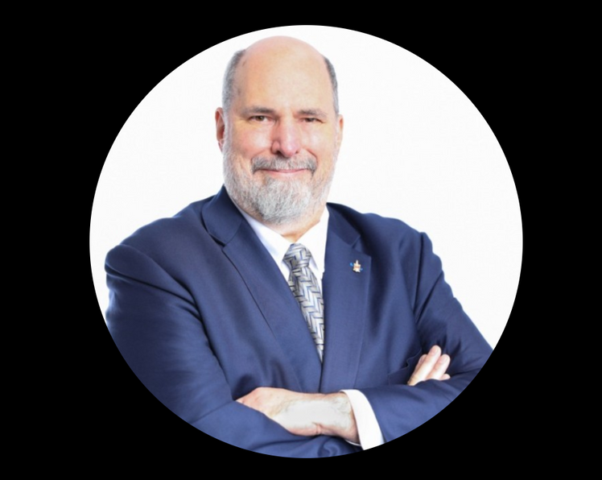
DR. ART MORRISH
Copyright © 2024 Baltic Ghost Wing Academy
22

Slide 12
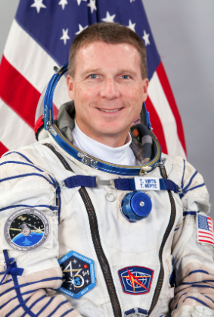
TERRY VIRTS
Former NASA Astronaut: Flew on the Space Shuttle Endeavour and commanded the International Space Station (ISS).
Retired Air Force Colonel: Served as a fighter pilot and test pilot with extensive experience in aerospace operations.
Author and Speaker: Wrote "View From Above" and frequently speaks on topics related to space, leadership, and exploration.
Photographer and Filmmaker: Known for capturing stunning images of Earth from space and contributing to the IMAX film "A Beautiful Planet."
STEM Advocate: Actively promotes science, technology, engineering, and mathematics education and inspires future generations to pursue careers in these fields.
Copyright © 2024 Baltic Ghost Wing Academy
22

Slide 13
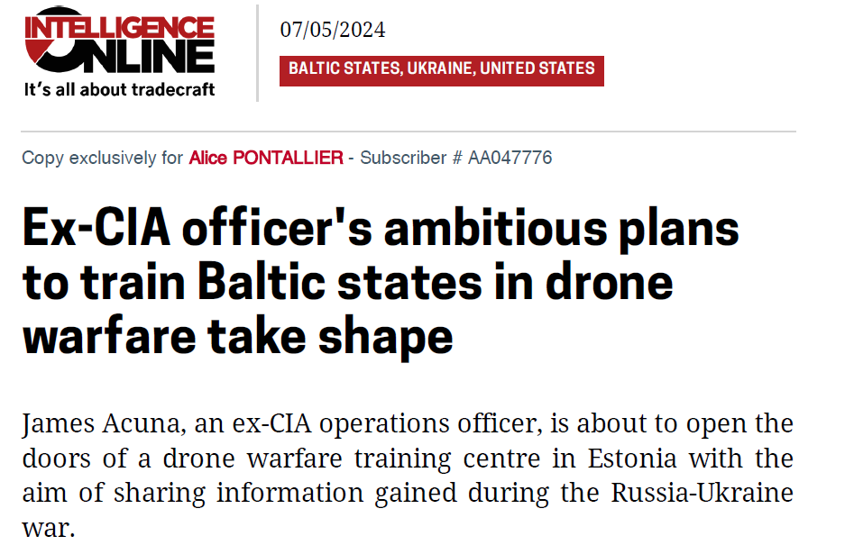
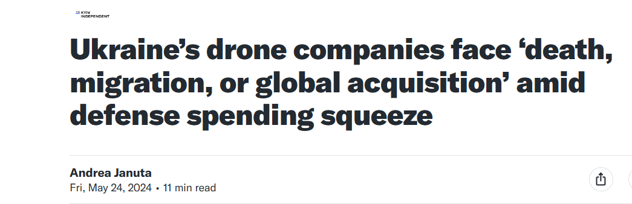
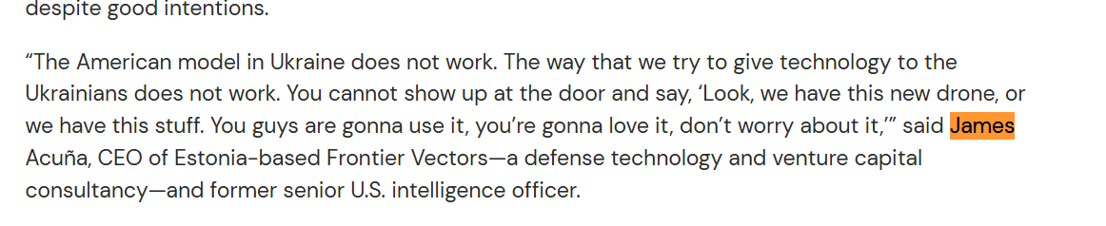

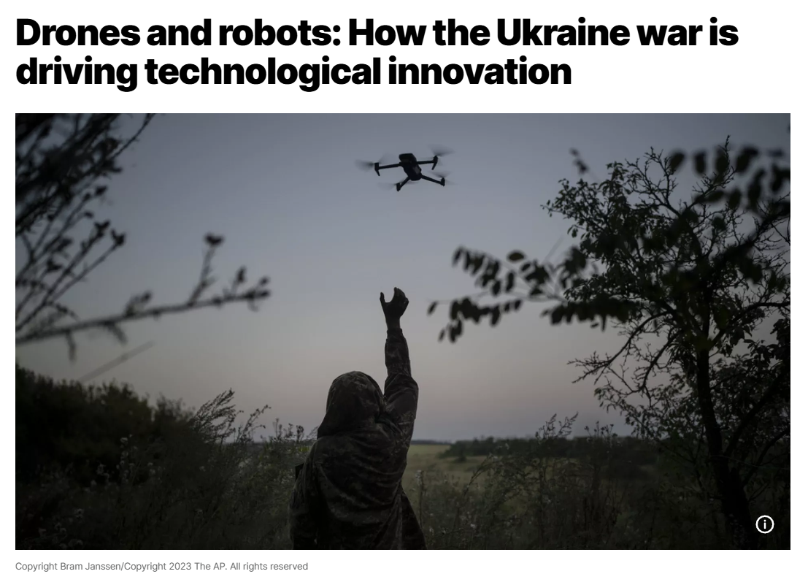
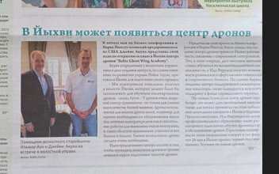
Bal
BALTIC GHOST WING MEDIA EXPOSURE
BGWCOE currently has over 8,000 followers on Linkedin and the founders have participated in over 20 interviews for the center prior to its launch. We also have commitments by large media organizations to cover its opening in 1Q 2025
Its founder James Acuna is often quoted in international media providing commentary on UAS warfare in Ukraine.
Copyright © 2024 Baltic Ghost Wing COE

Slide 14



Bal
BALTIC GHOST WING MEDIA EXPOSURE
The founders of BGWCOE maintain social media following of over 75,000 on various platforms and are experts in social media.
James Acuna started several popular Facebook groups and grew them to over 45,000.
Copyright © 2024 Baltic Ghost Wing COE

Slide 15

PROJECTED TRAINING
NATO Center of Excellence (TBA)
Middle East High Temp Training
Police Tactics/CQB
MIL FPV
COMMERCIAL FPV/RECON
BGWCOE provides the framework and instructor base to complete all sorts of advanced training and testing. We provide the facilities and instructors when required.
Copyright © 2024 Baltic Ghost Wing COE

Slide 16
ADVANCED TRAINING POSSIBILITIES
Copyright © 2024 Baltic Ghost Wing COE

Slide 17
TRAINING CENTER CURRICULIM
13 Week advanced training (comprised of individual units. May need multiple trips to complete)
1-2 Week core training in Rotor/Fixed Wing/FPV
1-3 Week FPV Engineering School
Train the Trainer customized training
Advanced survivability/night flying
Advanced Navigation Courses
Advanced Oil&Gas/LIDAR/TTPs
Final Proving Ground Exercises
BGWCOE works in conjunction with Jõhvi city government in relationship to computer and private/public classrooms.
Copyright © 2024 Baltic Ghost Wing COE

Slide 18
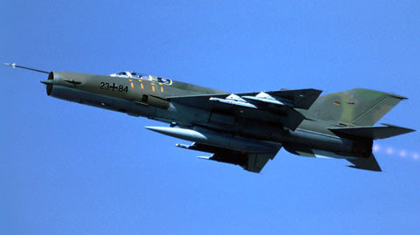
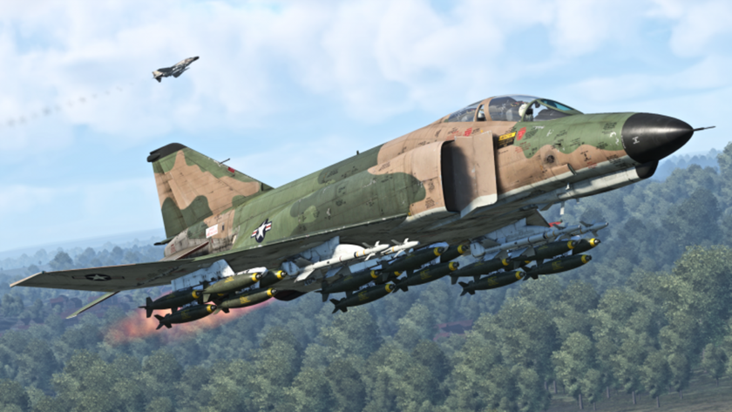
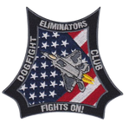
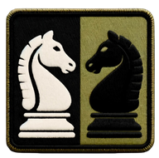


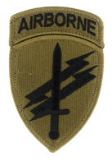

BGWCOE CONCEPT IS BASED ON
NAVAL FIGHTER WEAPONS SCHOOL AKA TOP GUN METHODOLOGY
DOGFIGHTING
TACTICS
DEBRIEFINGS
ADV. TACTICS
PSYCH
PEER LED TRAINING
Copyright © 2024 Baltic Ghost Wing
9
Notes:
The Vietnam War was a significant turning point for aerial combat strategies, leading to major changes in how the United States trained its fighter pilots. The creation of the Navy Fighter Weapons School, commonly known as "Top Gun," was directly influenced by the lessons learned during this conflict. Here are some of the top lessons that shaped its curriculum:
Importance of Dogfighting Skills: During the Vietnam War, U.S. pilots encountered unexpected challenges from the agile and often technically inferior North Vietnamese MiGs. This revealed a deficiency in close-range combat skills among U.S. pilots, as prior training had heavily favored missile engagements over traditional dogfighting. The need for proficiency in close aerial combat became a foundational element of Top Gun's training program.
Advanced Tactics and Maneuvering: The war highlighted the necessity for pilots to understand and execute complex aerial maneuvers. Top Gun incorporated advanced tactical training that emphasized outmaneuvering the enemy, utilizing the aircraft's capabilities to their fullest, and understanding the limits of both the aircraft and the pilot.
Mission Debriefings: Critical analysis of each mission played a crucial role in improving performance. The detailed debriefings that became a staple of Top Gun training helped pilots learn quickly from their mistakes and successes, fostering a culture of continuous improvement and adaptability.
Adversary Tactics Training: Exposure to and understanding of enemy tactics were lacking in the early stages of the Vietnam War. Top Gun introduced "adversary" or "aggressor" squadrons that used similar tactics and aircraft as the enemy, providing realistic training and helping pilots anticipate and counteract enemy maneuvers effectively.
Interdisciplinary Knowledge: The war underscored the importance of comprehensive knowledge of all aspects of aerial warfare, including expertise in weapons systems, radar, electronics, and survival skills. Top Gun's curriculum was designed to produce well-rounded pilots who were experts not only in flying but also in the technological and strategic elements of modern aerial combat.
Importance of Psychological Readiness: The stresses and demands of aerial combat in Vietnam revealed the need for psychological resilience. Top Gun incorporated mental conditioning into its training, preparing pilots to handle the pressures of combat and make swift, effective decisions under duress.
Peer-Led Training: Top Gun was established on the principle that experienced fighter pilots are the most effective instructors. This peer-led training approach ensured that the lessons were practical, battle-tested, and immediately applicable, enhancing the learning process.

Slide 19
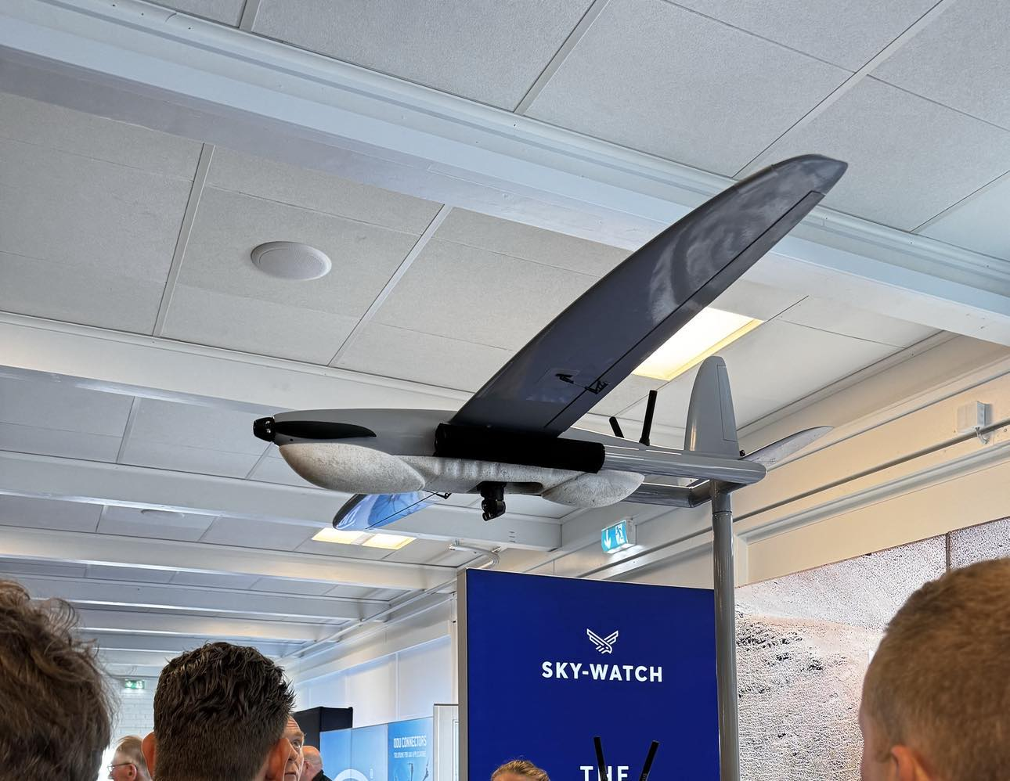
“"Per adversa ad caelos: artem gubernandi excelsius perficimus."
"Through adversity to the skies: we perfect the highest art of piloting."
Copyright © 2024 Baltic Ghost Wing
26

Slide 20
ADVANCED PILOTING CURRICULUM- 13 WEEKS
FINAL EXAM (1 week)
FPV
ROTOR
WING
ELECTIVES
3 WEEKS
ELECTIVES
3 WEEKS
ELECTIVES
3 WEEKS
ELECTIVES
3 WEEKS
PSYOPS
SENSOR FAM
NAVIGATION
ADV CUAS
FPV ADVANCED
3 WEEKS
ROTOR ADVANCED
3 wks
WING ADVANCED
3 wks
CARTOGRAPHY
FOREIGN UAS
FPV ENGINEERING
SENSORS
PHOTOGRAPHY
EXAM
FPV 2
(1 wk)
ROTOR 2
(1 wk)
WING 2
OIL&GAS
CINEMAPHOTOGRAPHY
FPV 1
(1 wk)
FPV 1
(1 wk)
ROTOR 1
(1 wk)
MAPPING
WING 1
A1-A2-A3
Copyright © 2024 Baltic Ghost Wing
13

Slide 21
PROPOSED YEARLY SCHEDULE 5x/yr
2 | FPV1 | ROTOR2 | WING1
3 | FPV1 | ROTOR2 | WING1
4 |  |  |  | FPV2 | ROTOR2 | WING2
5 |  |  |  | FPV2 | ROTOR2 | WING2
6 |  |  |  | FPV2 | ROTOR2 | WING2
7 |  |  |  |  |  |  | FPV ADVANCED | RA | WA
8 |  |  |  |  |  |  | FPV ADVANCED | RA | WA
9 |  |  |  |  |  |  | FPV ADVANCED | WA | WA
10 | FPV1 | ROTOR1 | WING1 |  |  |  |  |  |  | E1 | E2 | E3
11 | FPV1 | ROTOR2 | WING2 |  |  |  |  |  |  | E4 | F5 | E6
12 | FPV1 | ROTOR2 | WING2 |  |  |  |  |  |  | E7 | E8 | E9
13 |  |  |  | FPV2 | ROTOR2 | WING2 |  |  |  | EX1 | EX1 | EX1
14 |  |  |  | FPV2 | ROTOR2 | WING2
15 |  |  |  | FPV2 | ROTOR2 | WING2
16 |  |  |  |  |  |  | FPV ADVANCED | RA | WA
17 |  |  |  |  |  |  | FPV ADVANCED | RA | WA
18 |  |  |  |  |  |  | FPV ADVANCED | WA | WA
19 | FPV1 | ROTOR1 | WING1 |  |  |  |  |  |  | E1 | E2 | E3
20 | FPV1 | ROTOR2 | WING2 |  |  |  |  |  |  | E4 | F5 | E6
21 | FPV1 | ROTOR2 | WING2 |  |  |  |  |  |  | E7 | E8 | E9
22 |  |  |  | FPV2 | ROTOR2 | WING2 |  |  |  | EX1 | EX1 | EX1
23 |  |  |  | FPV2 | ROTOR2 | WING2
24 |  |  |  | FPV2 | ROTOR2 | WING2
25 |  |  |  |  |  |  | FPV ADVANCED | RA | WA
26 |  |  |  |  |  |  | FPV ADVANCED | RA | WA
27 |  |  |  |  |  |  | FPV ADVANCED | WA | WA
28 | FPV1 | ROTOR1 | WING1 |  |  |  |  |  |  | E1 | E2 | E3
29 | FPV1 | ROTOR2 | WING2 |  |  |  |  |  |  | E4 | F5 | E6
30 | FPV1 | ROTOR2 | WING2 |  |  |  |  |  |  | E7 | E8 | E9
31 |  |  |  | FPV2 | ROTOR2 | WING2 |  |  |  | EX1 | EX1 | EX1
32 |  |  |  | FPV2 | ROTOR2 | WING2
33 |  |  |  | FPV2 | ROTOR2 | WING2
34 |  |  |  |  |  |  | FPV ADVANCED | RA | WA
35 |  |  |  |  |  |  | FPV ADVANCED | RA | WA
36 |  |  |  |  |  |  | FPV ADVANCED | WA | WA
37 | FPV1 | ROTOR1 | WING1 |  |  |  |  |  |  | E1 | E2 | E3
38 | FPV1 | ROTOR2 | WING2 |  |  |  |  |  |  | E4 | F5 | E6
39 | FPV1 | ROTOR2 | WING2 |  |  |  |  |  |  | E7 | E8 | E9
Copyright © 2024 Baltic Ghost Wing Academy
14

Slide 22
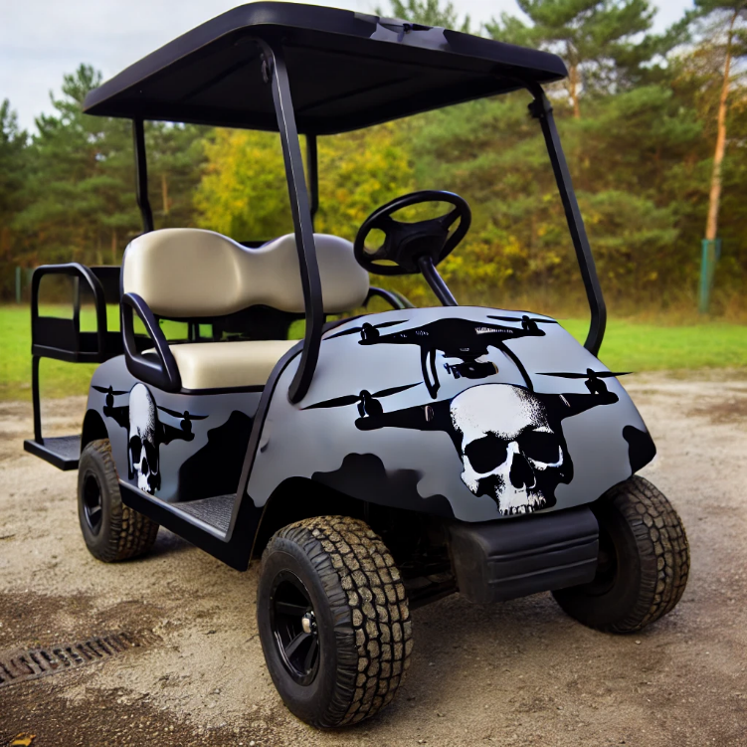
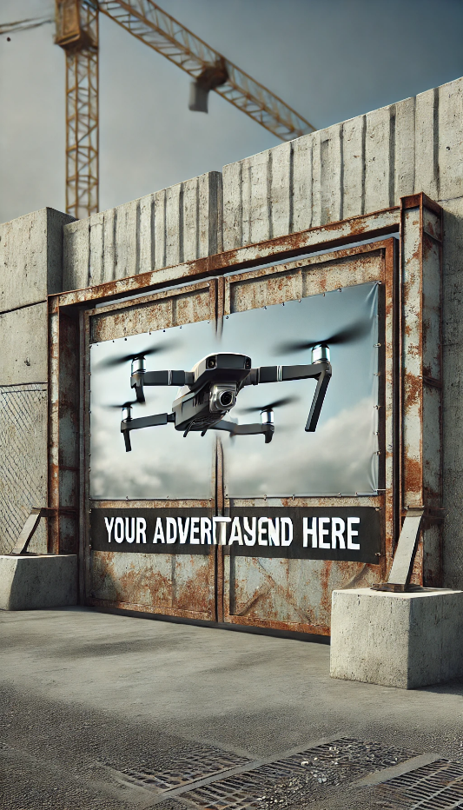
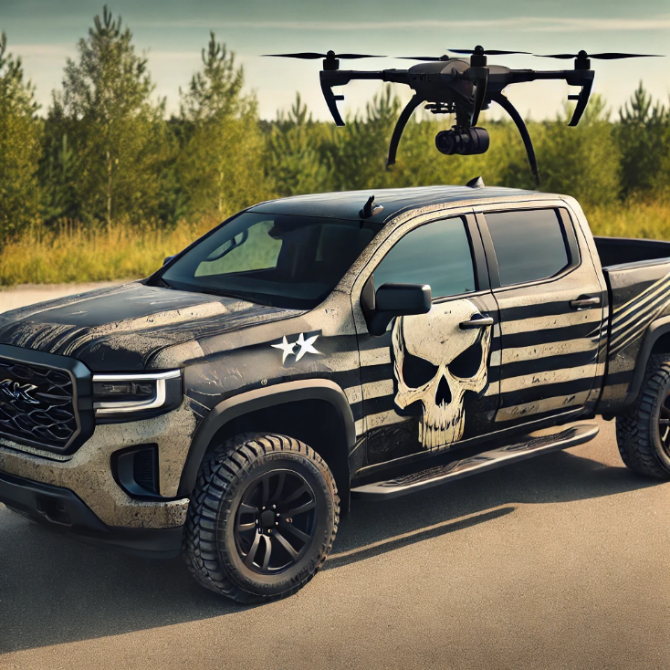
OTHER OPPORTUNITES
DRONE/FPV RACING
TEEN/PRE-TEEN KIDS COURSES
DRONE TRADE SHOWS/SEMINARS
SECURED DRONE PROVING GROUNDS
ADVANCED FPV PERFORMANCE TEAM
Copyright © 2024 Baltic Ghost Wing Academy

Slide 23

THANK YOU
JAMES ACUNA
james@balticghostwing.com
+37253671607
+17036244051 (Signal)

